Slide 1
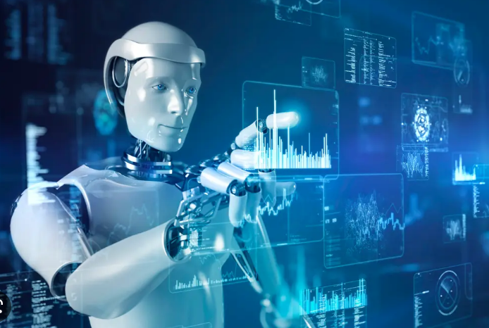
Med-ex Chatbot
By: Naga Sai Mahith Ganji
(UIN: 01239353)

Slide 2
INTroduction
A chatbot is a synthetic person, animal, or other thing that communicates with people online. This communication may be conducted verbally, through text (typed), or even nonverbally. Although chat bots can be used on local PCs and mobile devices, most people access them online. Most people think of chat bots as interesting software characters that they can communicate with. It may be intriguing, motivating, and interesting. It can be found everywhere, from outdated HTML pages to cutting-edge social networking websites, and from desktop PCs to posh mobile phones. Almost all of the major languages are spoken by chatbots. Their natural language processing (NLP) abilities range from very weak to incredibly bright, practical, and humorous. The same may be said of their graphic design, which occasionally resembles a childish cartoon figure. On the other hand, there are photo-realistic 3D animated characters accessible, which are difficult to identify from humans. And "chat bots" is the term used to describe each of them.

Slide 3
What are Chatbots?
A conversational agent known as a chatbot converses with users in everyday language.
They began as an effort to trick people.
There are several uses for chatbots, including customer service and call centers.

Slide 4
WHAT IS MED-EX CHATBOT?
The users' biggest issue is that they don't know how to take the medication for their allergies without a doctor's prescription and deal with the terrible side effects of the medication. To address this issue, I'm developing a chatbot called Med-ex. This project is a chatbot about pharmacy products that will provide users with in-depth information about medications that are FAQs (Frequently Asked Questions) by describing the diseases we are experiencing and their symptoms, the bot will then prescribe the medication we should take and will also explain any side effects that may appear after taking the medication. The chatbot typically responds to the questions that users ask most frequently.

Slide 5
Need for chatbots
Usage of personal devices on a large scale.
An improved human-computer interface.
"To speak, type, and point naturally to express their interest, wants, or inquiries."

Slide 6
Problem with current scenario:
People who are not more tech-savvy are typically unaware of the chat bot system.
Even if chat bots are a thing, they are not very good at proving answers or solutions.
Since the user have no idea about which medication they should take while they affect with some disease they consult the doctor, this process takes a lot of time and money.
Additionally, this procedure might cause a time killing and the expenses for the doctor appointment for the patient.

Slide 7
How do Med-ex Chatbots work?
Not being able to follow conversations well
Using pattern matching.
There are input and output rules for chatbots.
Recognizes the user's cue phrases and provides a pre-planned response.
For e.g.:
Human: "I am suffering from fever”.
Bot: “What are your symptoms?“
Other chatbots gain knowledge from user interactions.

Slide 8
System requirements:
1. Hardware requirements
Processor-Intel Pentium or higher
RAM-minimum->4GB
maximum->6GB
2. Software requirements
Front End- OS-Windows 7,8,10
Back End- Python must be installed

Slide 9
applications
Accessible any time.
Handling capacity.
Flexible attribute.
Customer satisfaction.
Cost effective.
Faster on boarding.
Work automation.
Personal assistant.

Slide 10
Advantages:
The user does not need to physically visit the hospital to make the inquiry.
The patients can stay informed about medication through this application.
The user, the doctor, all benefit from time savings from this application.

Slide 11
Disadvantages:
Lack emotion.
Difficult to create.
Require maintain.

Slide 12
Limitations
The effectiveness of a chatbot is heavily dependent on language processing, which is constrained by inconsistencies like accents and errors that can be a major hurdle for global and multi-cultural enterprises.
Chatbots can't answer numerous inquiries at once, consequently there are few opportunities for conversation.
Chatbots need a lot of conversational data to function to train.
As is typical with technology-driven modifications to established services, some customers, typically from the older age, find Chatbots unsettling because of their limited knowledge, which makes it clear that their requests are being handled by robots.

Slide 13
conclusion
Chatbots are useful tools for e-commerce, IR, and other fields.
The goal of chatbot designers should be to create tools that support people, ease their work, and allow them to communicate with computers in natural language; not to completely replace people or replicate human speech.

